Slide 1





HydraAI- AI Based Water Requirement Prediction System
Team Lead – Om Deshmukh
Team Member 1 - Karan Vasani
Team Member 2 - Akanksha Patil
Team Member 3 - Samarth Jadhav
Mentor Name – Saurabh Tembhurne sir
College Name - Ajeenkya DY Patil University

Slide 2

Project Objectives
Our main objectives are:
    To develop an AI system for accurate water prediction.
    To analyze weather and soil parameters.
    To reduce water wastage in agriculture.
    To support sustainable farming practices.
In simple words, we want to save water and increase crop productivity.

Slide 3
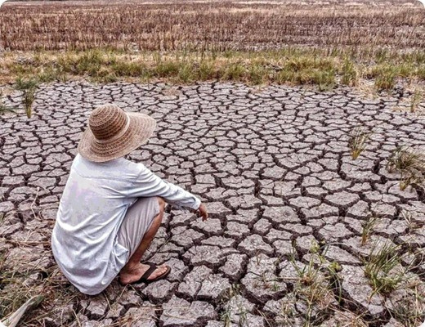
Problem Statement :
Agriculture consumes a massive portion of global water resources. Traditional methods are inefficient, leading to :
    Overwatering or severe underwatering.
    Significant wastage of fresh water resources.
    Reduced crop productivity and health.
    Lack of scientific decision support systems.

Slide 4
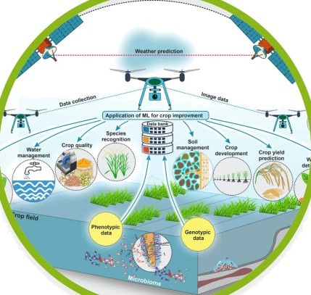
Project Overview – Introduction :
This project uses Artificial Intelligence to predict the water requirement of crops based on environmental factors. It helps farmers optimize irrigation, reduce water wastage, and support precision agriculture .
    Neural Network-based prediction.
    Real-time water estimation.

Slide 5


.
.
End Users :
Agri-Tech
Farmers
Researchers
    Integrates AI into smart irrigation and farming systems.
    Supports precision agriculture and automation.
    Optimizes daily irrigation based on weather conditions.
    Improves crop yield and reduces water wastage.
    Analyzes environmental data for resource management.
    Studies crop-water relationships and climate impact.

Slide 6
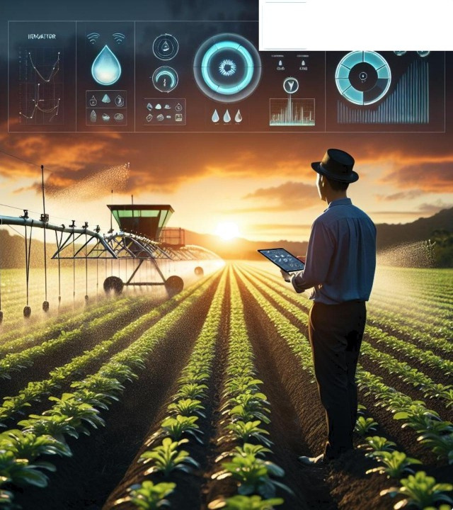
Wow Factors in Project :
Intelligent Smart Farming
    Neural Network Core: High-precision prediction model.
    Real-time Interface: Streamlit web application.
    Automated Flow: Feature engineering without manual bias.
    User-Centric: Dashboard designed for non- technical users.

Slide 7
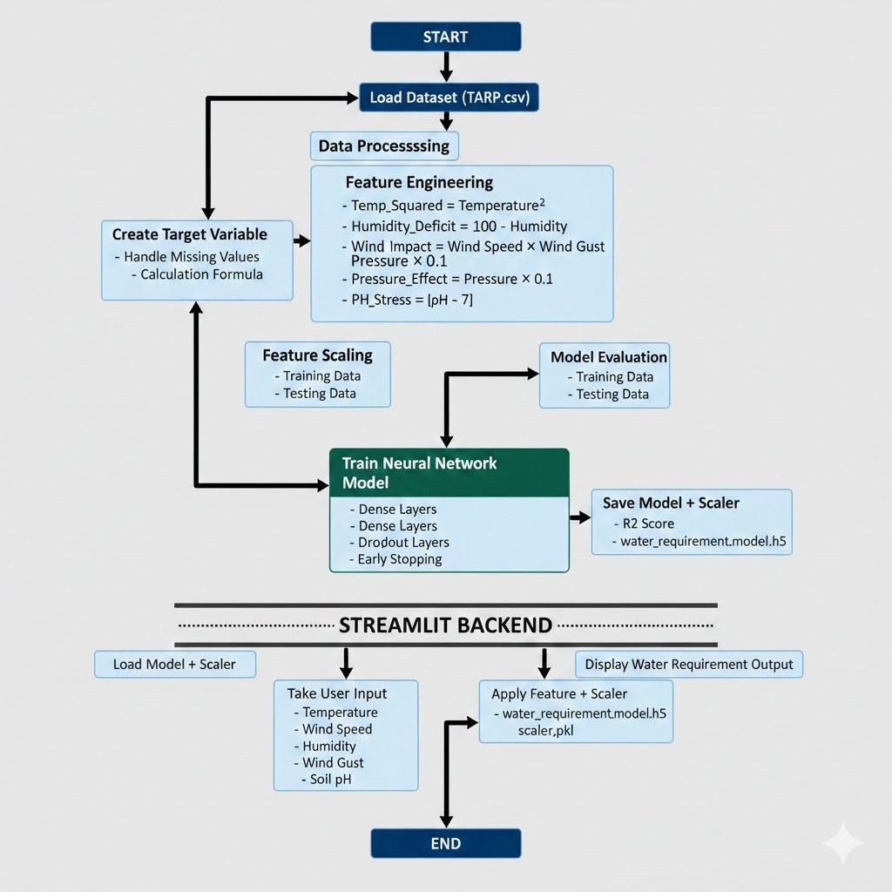

Modelling/Block Diagram/Flow of Project :

Slide 8
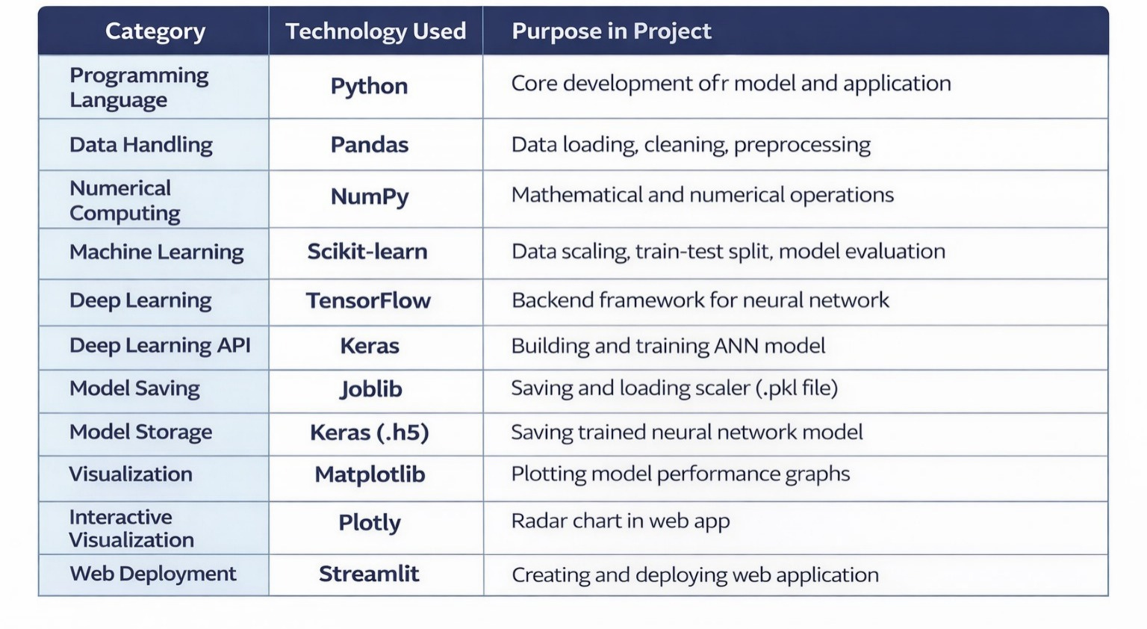
Technology Stack :

Slide 9

Result/Outcomes :
Prediction Accuracy
Water Savings (Est.)
Irrigation Efficiency
78% Improve

Slide 10
Conclusion :
“The project successfully demonstrates that Al can transform irrigation management, boosting productivity while ensuring environmental sustainability”

Slide 11
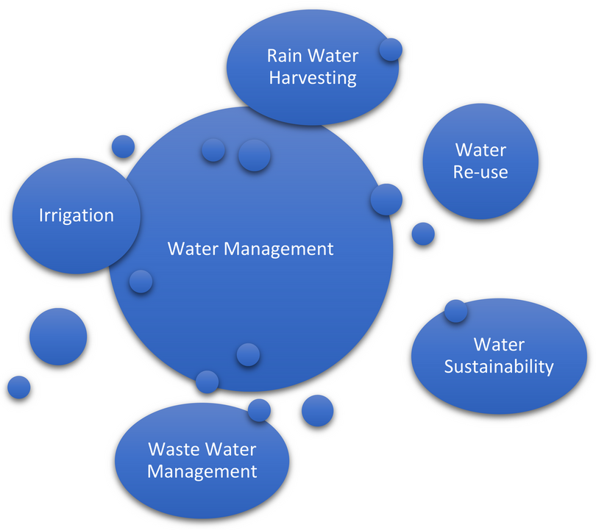
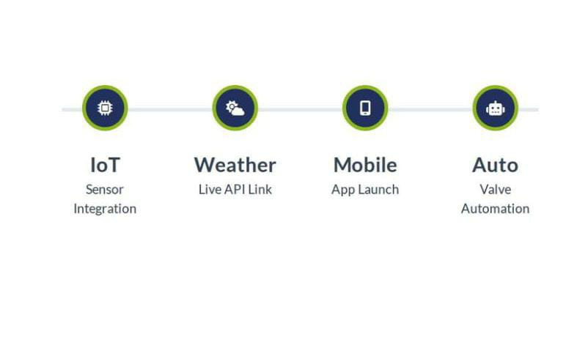
Future Perspective :

Slide 12
Thank You
GitHub Link -https://github.com/ideshmukhom-eng/HydraAI-Smart-Irrigation

